Slide 1
Insurance Analytics and Prediction
Name : MOHAMED HANNAN
Master in Data Science – GUVI
Mail : hannanmohamed4664@gmail.com

Slide 2
Objective:
The objective of this initiative is to assess the financial needs based on individual health circumstances and develop a predictive solution for determining personal health insurance premiums.
The project aims to enhance decision-making processes, optimize risk classification, and improve customer satisfaction in the insurance industry.
To Provide an annual estimate of the required amount based on personal health status.
Encourages individuals to prioritize their health within the insurance context.
Facilitates in determining health insurance premiums.

Slide 3
Data Collection and validation
The dataset was sourced from the Kaggle platform.
The data types of columns were examined to ensure accuracy, and any discrepancies were rectified.
Null values or missing information in dataset columns were identified and addressed.
Data preprocessing techniques were employed to prepare the dataset for analysis.
Exploratory data analysis was conducted to gain insights and understand patterns within the data.
Statistical methods were applied to validate the integrity of the dataset.

Slide 4
Data Pre-processing:
Conduct exploratory data analysis (EDA) to uncover patterns within the data, such as distribution characteristics and the presence of outliers.
Identify and address any null values within the dataset through imputation techniques.
Encode categorical features or columns to facilitate their inclusion in analysis or modelling.
Apply StandardScaler to standardize the values and ensure consistency in scale across features.

Slide 5
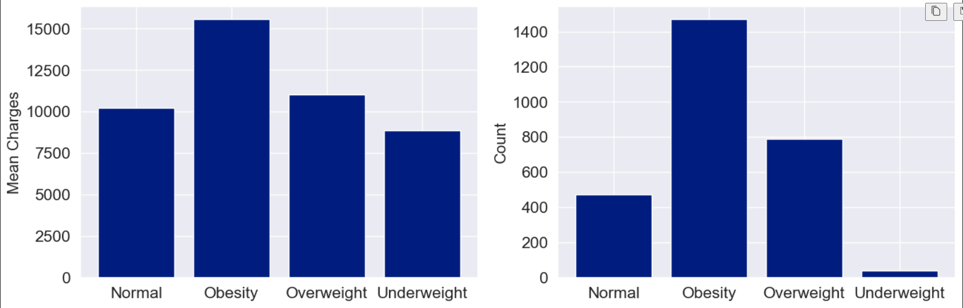
BMI vs Charges

Slide 6
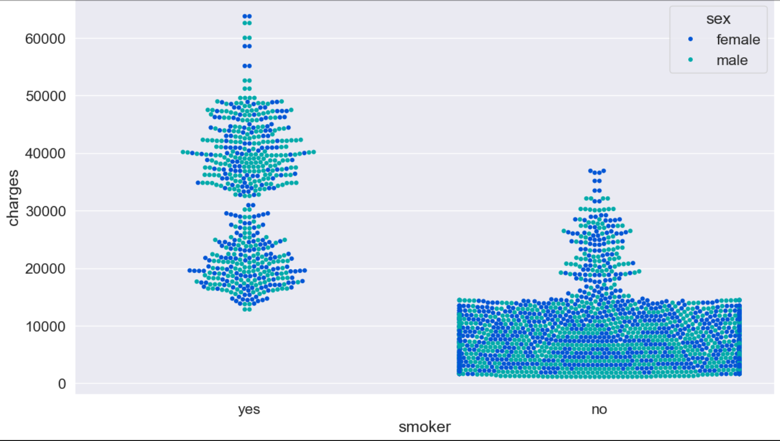
Scatter Plot of Smoker vs Charges

Slide 7
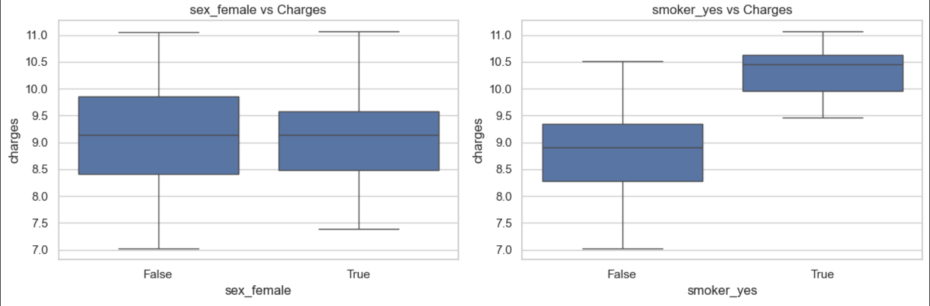
Sex and Smoker vs Charges

Slide 8
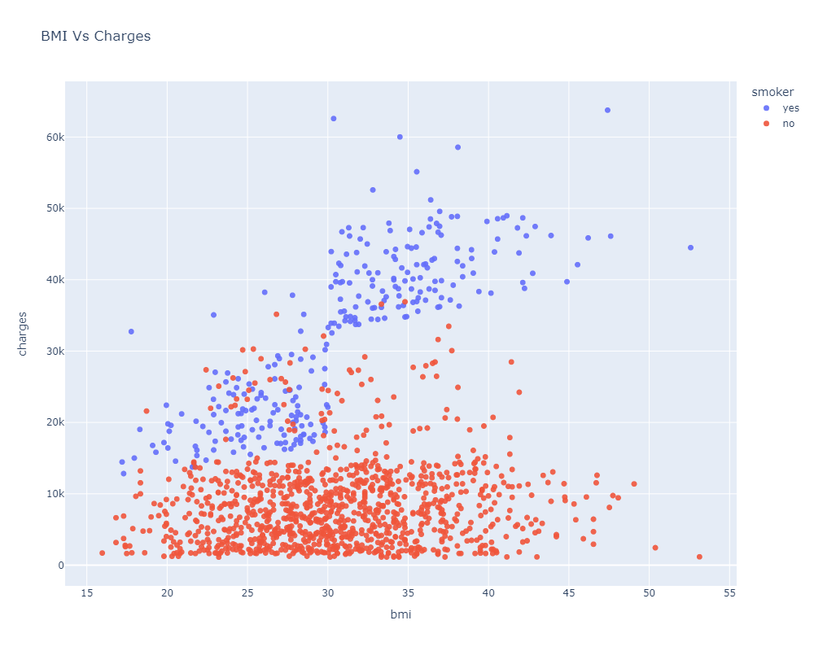
Scatterplot for Charges incurred by Smokers

Slide 9
Model Selection
Post preprocessing and model training, we've identified the optimal model for premium prediction.
The model underwent training across various regression and classification algorithms, including Linear, Decision Trees, Random Forest, and K-Nearest Neighbors (KNN).
Following predictions, we'll assess the accuracy using evaluation metrics such as RMSE (Root Mean Squared Error) and r2_score (R-squared).
For Clustering, Kmeans algorithm is used to for customer segmentation.

Slide 10
Predictions
Subsequently, all trained models were applied to validate the test set.
Pre-processing techniques were implemented on the test set to ensure consistency and comparability with the training data.
The model with the best RMSE and r2 score was selected and preserved for premium prediction.
Further steps involved optimizing the selected model parameters to enhance its predictive performance.
Rigorous testing and validation procedures were conducted to ensure the reliability and accuracy of premium predictions.

Slide 11
Conclusion
The model’s prediction are greatly influenced by whether a person smokes, with age and bmi being the next most important factor.
These results highlight that smoking status and age are crucial in predicting medical costs.
By using different classification models, we will get better at identifying fradulent insurance claims. This will help reduce money loss due to fraud and improve how accurately we review claims.

